Slide 1
Accounts Payable II

Slide 2
Contents
Vendor Transactions
Reconciliation Account
Special General Ledger
Automatic Payment Program
Reports
Notes:
Explain the lesson coverage

Slide 3
Vendor Invoice
Clearing
Manual payment process
Document Header
Vendor Transaction

Slide 4
Vendor Invoice Posting
You enter the general data for the posting document on the screen in the document header, for example, invoice and posting date, text, and so on. For entering invoice and credit memos received, you can define a document type for each transaction, which then appears as a general default value
You can overwrite this proposed document type at any time as long as the document type field is ready for input during document entry
If you do not define a document type, the system proposes standard document types; for example, KR for entering vendor invoices
Value Date means, the date on which the funds will be available (In case of Vendor postings – to the Vendor. In the case of Customer – from the customer)
Enter the additional line items for the document in the table in the bottom section of the screen
The account name appears once you have made and confirmed your entries
You can select different fields or columns and change the size and sequence of the columns and fields
At the top of the screen, you can select from Park, Post, or Hold, to complete the document entry transaction once the balance is zero, but you can Park or Hold document even if document doesn’t have zero balance

Slide 5
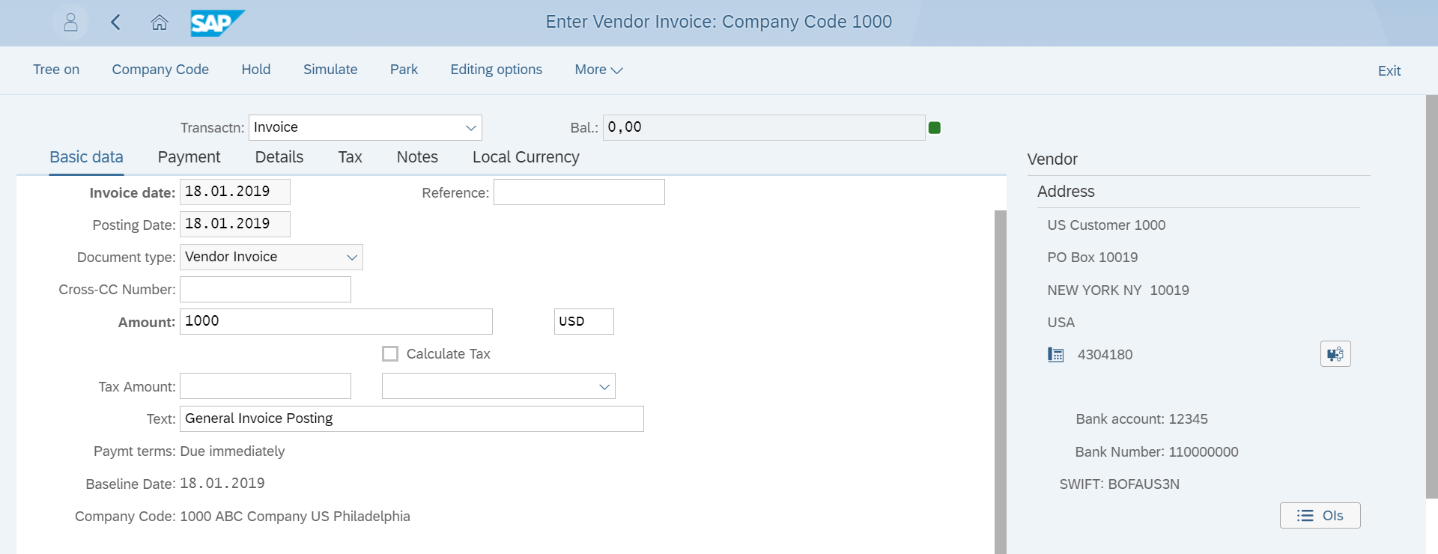
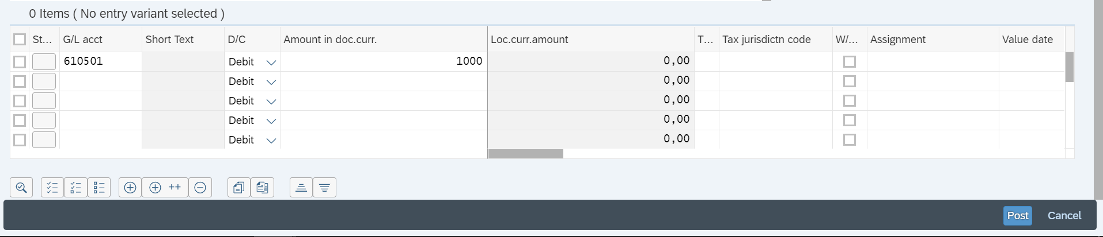
Create Incoming Invoices
1.Select the invoice Date
2.Enter Invoice Amount
3.Enter Invoice Text
4.Enter the GL account to be debited
5.Enter the Invoice Amount
6.Click on Post

Slide 6
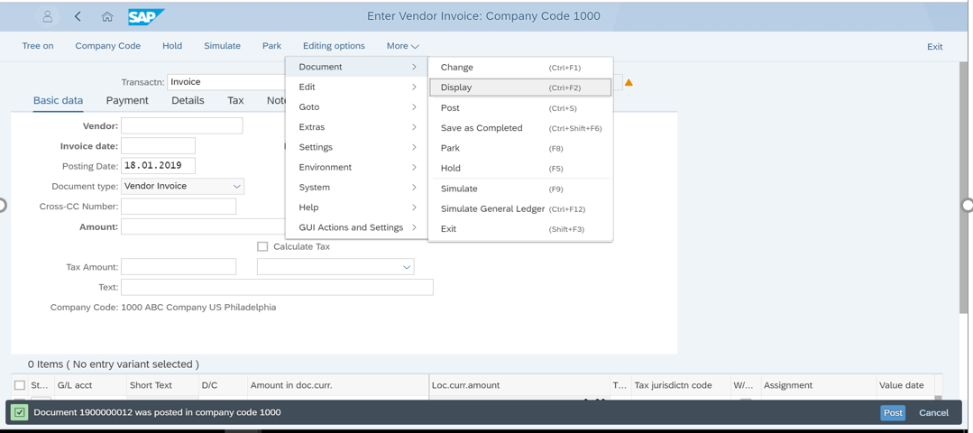
Create Incoming Invoices
7.In order to display the Invoice click here
8.Invoice Document Posted

Slide 7
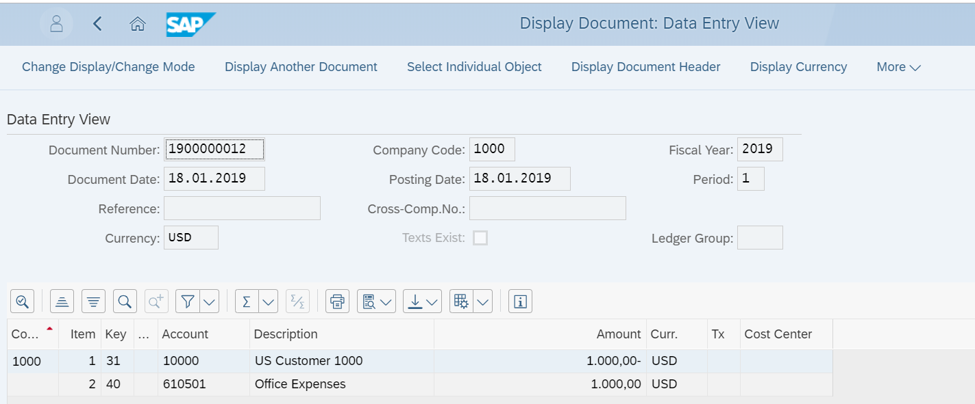
Create Incoming Invoices
9.Invoice Document

Slide 8
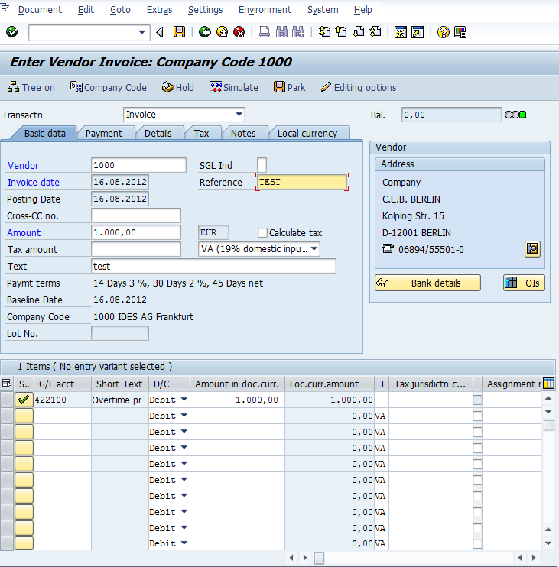
Vendor Invoice Posting T-Code FB60
Notes:
Payment differences s

Slide 9
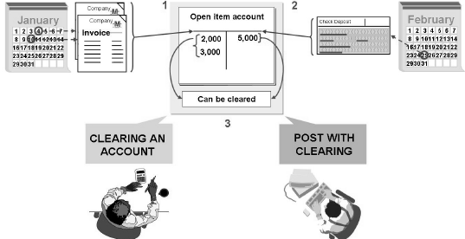
Clearing Open Items
Open items are incomplete transactions, such as invoices that have not been paid
Documents cannot be archived until they are cleared
Types of clearing in SAP Financials:
Post with clearing
Account clearing
A clearing transaction always creates a clearing document

Slide 10
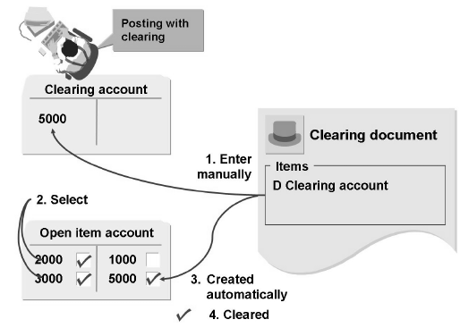
Post with Clearing
When you use the "posting with clearing" function, enter the clearing document amount and then select the open items that are to be cleared
If clearing amount equals selected open items amount system clears it
If there is any difference system allows to post the difference
Post with clearing can be done either manually or by Automatic Payment Program

Slide 11
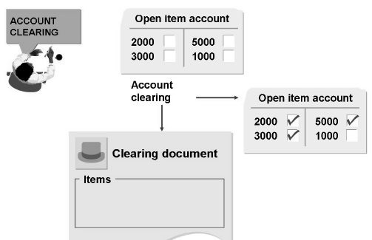
Account Clearing
Using the account “clearing function”, choose those open items from an account that balance to zero. The system marks them as cleared and creates a clearing document
Account clearing function works for any account managed with open items in the general ledger and in sub ledgers
Account clearing can be done either manually or by Automatic Clearing Program

Slide 12
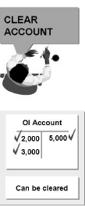
Automatic Clearing Program
Steps in the clearing program
Group items for each account
If balance is zero, items are marked for clearing
Prerequisites for clearing
User criteria must be defined in customizing
Accounts to be cleared must be defined for automatic clearing
Items that are not cleared:
Noted Items
Statistical postings, bill of exchange postings
Items with withholding tax entries

Slide 13
Manual Payment Process
A manual payment is a transaction that clears an open item, typically an invoice, by manually assigning a clearing document
An incoming payment, typically used in Accounts Receivable, clears an open debit amount
An outgoing payment, typically used in Accounts Payable, clears an open credit amount
A manual payment is processed in three steps:
Data is entered in the document header
Open items are selected to be cleared
The transaction is saved

Slide 14

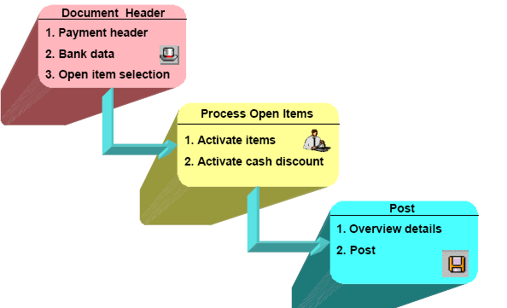
Manual Vendor Payment Process

Slide 15
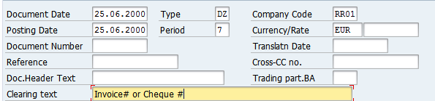
Document Header: Payment Header
Notes:
There are 3 sections to the document header:
The payment header
Bank data
Open item selection.

Slide 16
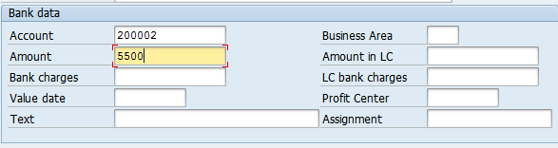
Document Header: Bank Data
Notes:
In Bank data, the account is a general ledger account number used for outgoing payment clearing and must be entered.
The payment amount is the total value of the payment being processed.
. The bank may charge bank charges for their services which are automatically posted to a special
expense account. In incoming payments, the system adds the bank charges to the payment amount
to form the clearing amount. In outgoing payments, it subtracts the bank charges from the payment
amount to form the clearing amount.
. The allocation number is either created by the system or may be entered manually.

Slide 17
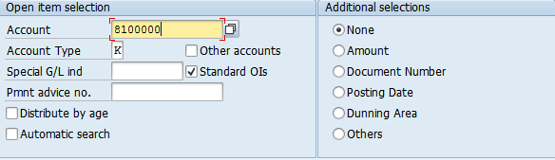
Open Item Selection
Notes:
Enter the following “open item selection” data in the next section of the document header:
. Account and account type
In this section, “account” refers to the business partner’s account number and their account type. K
refers to vendors and D refers to customers. The account and account type are required to
determine the account in which the open items reside.

Slide 18
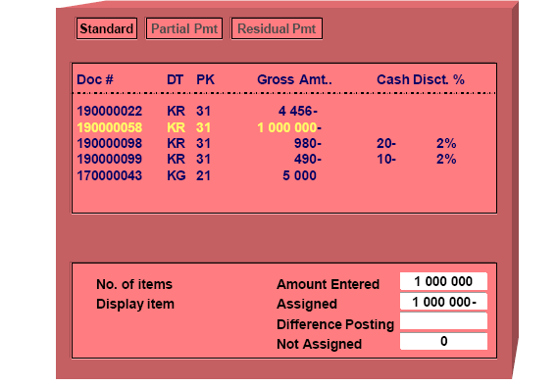
Process Open Items
Notes:
These could be payments, debit or credit memos or invoices. Depending on your settings, all of the items may be selected or de-selected when you initially get to this screen.
n The first step in processing open items is to activate the required line items to allocate a payment.
n The amount entered is allocated to the appropriate line item in proportion to the item amount and
discount.

Slide 19
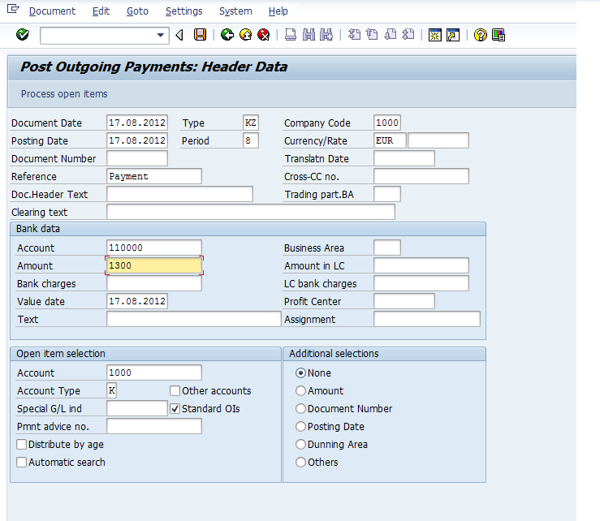
Posting Outgoing Payment Transaction code F-53
Notes:
Payment differences s

Slide 20

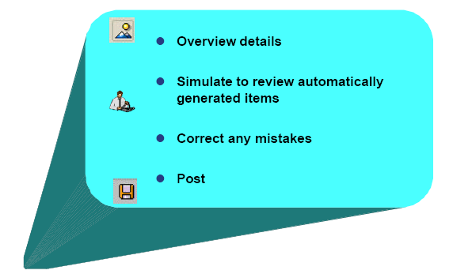
Post Payment

Slide 21
Processing Down Payments in the S/4 HANA
Down payments are posted to separate special G/L accounts depending on the down payment type. (Ex. Down payments made on tangible fixed assets or on inventory stocks)
You can post or clear the down payments manually or have the payment program post them
You must make transfer postings for down payments manually. When you make a transfer posting, the system clear the down payment and posts the same amount to the customer or vendor account

Slide 22
Document header
Document header consists of three sections:
Payment header
Bank data
Open item selection
Important fields need to be filled in payment header are company code, dates, document type (defaulted) etc.
Important fields in Bank data are Bank/cash Account number, amount, value date etc.
Fields in open item selection customer/vendor account, account type (K,D)
For selecting the open items there are certain features like
Distribute by age (items according to days in arrears)
Automatic search (shows the OI’s which matches the data filled above)
Can make additional selections for selecting open items
Special G/L’s can also be cleared

Slide 23
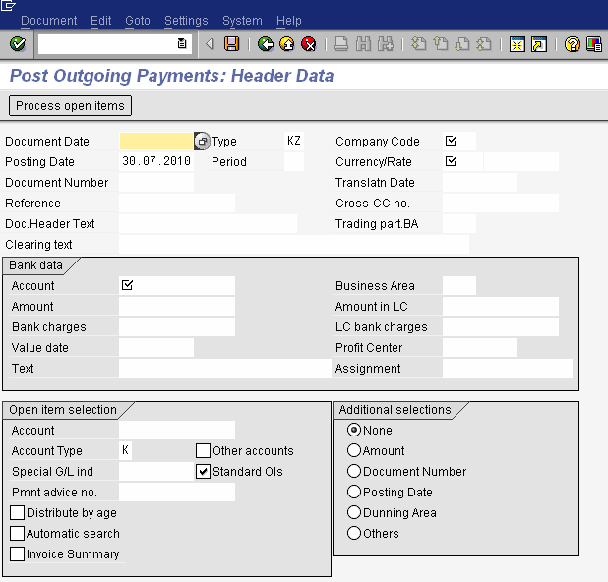

Slide 24
Processing Open Items
Select the process open items after entering data in document header
Select the required open items
You can post the document if the amount entered is the same as the amount assigned
You can directly save the document, or can simulate to view automatically generated line items also can correct mistakes done
Posting difference are shown in coming slides

Slide 25
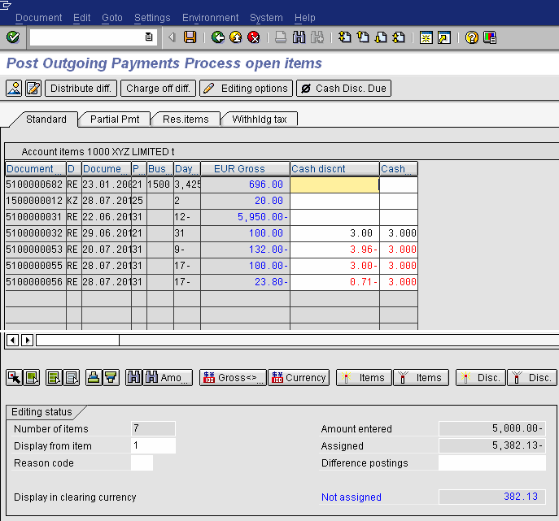

Slide 26
Automatic Postings when Clearing Open Items
Cash discount expense or revenue
Cash discount clearing (net procedure)
Tax adjustments
Exchange rate differences
Bank charges
Clearing for cross-company code payments
Over-or under payments within tolerances

Slide 27
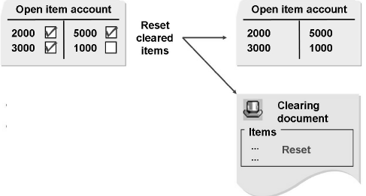
Reset Clearing
When line items are cleared with error, cancel clearing by resetting clearing document and cleared items
After reset the cleared items will become open items as like earlier

Slide 28
Reconciliation Account
Transactions in the sub ledgers (AR/AP) are also posted on the reconciliation accounts in the general ledger, to have the values available in form of totals as well in the general ledger in order to be able to quickly create a financial/income statement
The Reconciliation Account field can be found in the company code segment of the customer/vendor master record
For example when you post a vendor, automatically the reconciliation account also gets posted
But
Certain business transactions should be displayed separately in the general ledger and sub ledger in financial accounting
Ex: Down payment to vendor is not a liability hence to be shown on assets side. Down payment request, Doubtful receivables etc.
For this type of transactions ALTERNATIVE RECONCILIATION ACCOUNTS are used

Slide 29
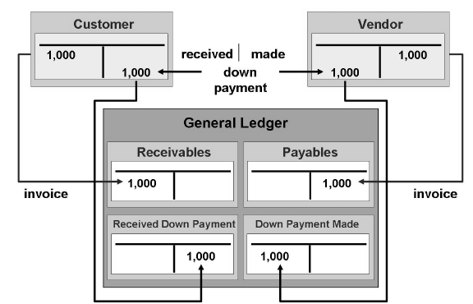
Alternative Reconciliation Account
Special G/L transactions are transactions in the accounts receivable and payable, which are displayed separately in the general ledger and the sub ledgers.
When you post vendor account, respective RECONCILIATION ACCOUNT is posted. When you post vendor account (using a SPL G/L INDICATOR), respective ALTERNATIVE. RECONCILIATION ACCOUNT is posted.

Slide 30
Special GL: Introduction
Special G/L transactions are various types of accounts receivable (AR) and accounts payable (AP) transactions that do not follow normal document posting logic and account determinations. They are posted using a special G/L indicator with a corresponding Posting Key. Each transaction will have an indicator which represents its type and properties that designate its posting method
Depending on company adopted accounting standards and reporting needs, special G/L transactions allow the aforementioned transaction types to be displayed appropriately in financial statements and/or notes to financial statements. For noted items and statistical entries, they provide an audit trail of non-conventional postings that are not included in the balance sheet. Rather than record such transactions outside of the system, they can be maintained in SAP to preserve financial data integrity and transparency. For real postings, alternative reconciliation accounts are used to segregate special G/L transactions from normal transactions and to enable flexible integration with the balance sheet

Slide 31
Special General Ledger Classes
Special G/L transactions can be divided roughly into three classes:
Down payments
Bills of exchange
Other transactions
Down payment request
Down payment
Bills of exchange payment request
Bills of exchange
Check/bills of exchange
Individual value adjustments
Guarantee of payment
Interest
User-defined
SAP system provides special preconfigured programs and entry screens for all
The processing of down payments is integrated in the dunning and payment programs

Slide 32
Special General Ledger Types
There are three ways (special general ledger types) of transferring special general ledger entries to the system.
Automatic offsetting entries (statistical):
Transactions which are always posted on the same offsetting account
They are usually included in the notes to financial statements
Example: Posting of a guarantee of payment
Noted items:
informational character which only remind the user about due payments or payments to be made and are not displayed/updated in G/L accounts
Only one line item is updated and no offsetting entry required, hence no zero balance check
Example: Down payment request
Free offsetting entries:
Part of financial statements and creates a proper posting in General Ledger
Freely defined offsetting entries
Example: Down payment received

Slide 33
Remember …
Special G/L Types | Alternative Reconciliation Account | Offsetting Entry | Examples
Noted items | Configured at Spl G/L indicator | Not required | Down payment request
Automatic offsetting entries | Configured at Spl G/L indicator | Configured at (Tcode: OBXS) Shown in coming slides | Guarantees
Manual offsetting entries | Configured at Spl G/L indicator | To be assigned manually | Down payment made/received

Slide 34
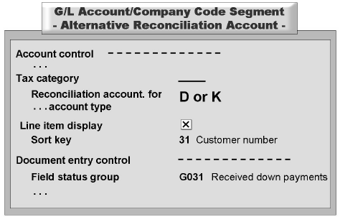
Configurations for Special G/L Transactions
Special GL transactions are posted by means of
Posting keys
Special GL indicators
Special G/L transactions are posted to an account stored in Customizing and not to the reconciliation account stored in the master record.
For Special G/L accounts line item display must be activated.
Configuration for Special G/L accounts must be as follows:

Slide 35
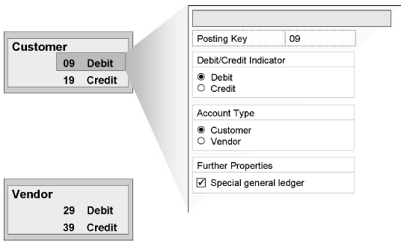
Posting Key for Special G/L Transactions
The special G/L transactions of the standard system are assigned to the posting keys {customer (09 and 19), Vendor (29 and 39)}

Slide 36
Special G/L Indicator
It is a pre configured single character indicator used to say the type of special G/L transaction
It is defined separately for each account type
Even though Spl G/L indicators are pre-configured, as per the requirement, we can change:
Different account numbers for reconciliation accounts or special G/L accounts
Other posting keys or G/L indicators for individual transactions
Other settings for the automatic postings, including the accounts to be posted to, posting keys and rules for account assignments with automatic postings
Account type is important, as special G/L indicators are configured separately for each account type
The special G/L indicator indicates that the posting key is used to enter special G/L transactions

Slide 37
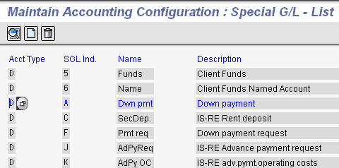
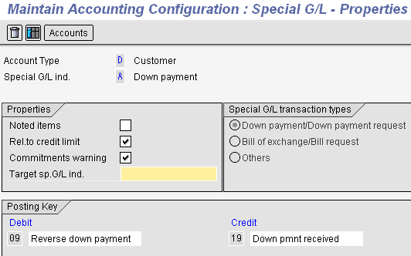
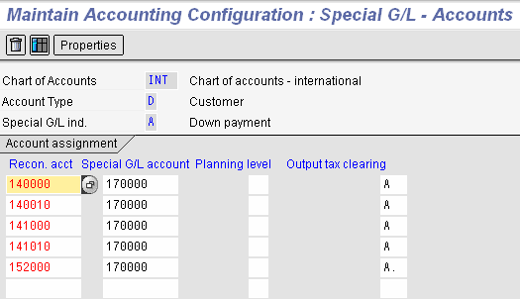

Slide 38
Special G/L Indicators: Properties and Accounts
The characteristics of each special G/L indicator are defined in connection with the account type under Properties
Noted items: You can determine that a special G/L transaction does not update any account balances.
Relevance to credit limit check: You can include special G/L transactions in the credit limit check for customers
Warning against commitments: You can determine that the user is notified by a warning message about the existence of a special G/L transaction when posting to a customer or vendor account
Target special G/L indicator: The target special G/L indicator is used in the standard system for down payment requests
Special G/L transaction class: The special G/L transaction class determines whether the transaction is a down payment, a bill of exchange or any other type of transaction
Posting key: Only these posting keys can be used with the respective special G/L indicators
The alternative Special G/L account is stored in the account determination according to the chart of accounts.
If a special G/L indicator is used when posting customer/vendor invoice, instead of posting to the respective reconciliation account the Alternative reconciliation account assigned in account determination gets posted.

Slide 39
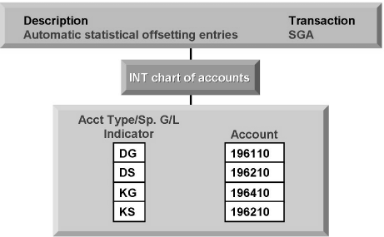
Automatic Offsetting Entries
Statistical postings are always made on the same offsetting account. The account is stored on the basis of a combination of the account type (customer or vendor account) and the special G/L indicator used
Configuration for automatic offsetting entries

Slide 40
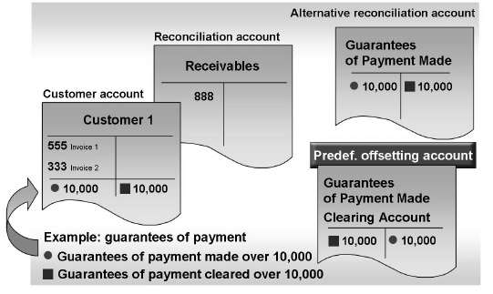
Example of Automatic Offsetting Entry
Two line items with postings on a predefined offsetting account

Slide 41
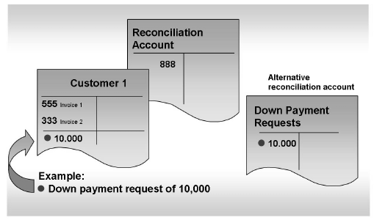
Example of Noted Item
Noted item is created.
The transaction figures are not updated in the general ledger in the process.

Slide 42
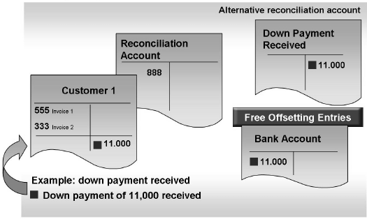
Example of Free Offsetting Entry
The account for the offsetting item is entered at the same time as the posting.

Slide 43
Vendor Down Payments
Down payments are used for short or medium – term financing. Generally the vendor or manufacturer does not have to pay interest on the down payment. Down payments are generally made before production begins or after partial completion
Down payments must not be balanced with other receivables or payables and must be displayed separately on the Balance sheet
On the balance sheet, down payments made are displayed on the asset side and down payment received on the liabilities side
Once you have received the goods or services for which you made a down payment, you need to clear this payment for the final settlement either manually or using the payment program

Slide 44
Special GL Accounts for Down Payments
Each down payment type is represented by a separate G/L indicator. The special indicator displayed in the following table are used in the standard system. You must create separate special G/L accounts for each down payment type
CODE | DOWN PAYMENT TYPE
A | General down payment (made or received)
M | Down payment made on tangible fixed assets
I | Down payment made on intangible fixed assets
V | Down payment made on inventory stocks
Notes:
Settings for Down Payment

Slide 45
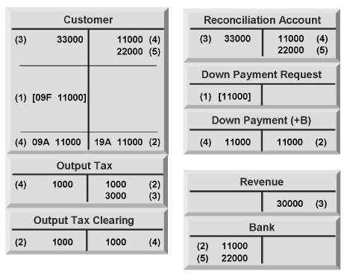
Example of Down Payment in Customer Area
The down payment request is posted
The down payment made is entered
The vendor invoice is created
The down payment is cleared
The payment is cleared during the payment of the balance

Slide 46
F110: Automatic Payment Program
Basically, there are 2 types of payment in SAP i.e manual payment (F-53, F-58) and automatic payment (F110)
For manual payment, you can choose many invoices in one time for posting an outgoing payment
But please notice that system can generate only 1 payment document. On the other hand, system allows you to do outgoing payment in mass via F110
The SAP payment program lets you automatically
Select open invoices to be paid or collected
Post payment documents
Print payment media, use data medium exchange (DME), or generate
Electronic data interchange (EDI)
The Automatic Payment Program has been developed for both national and international payment transactions with vendors and customers , and handles both outgoing and incoming payments. The Configuration needed (FBZP) to execute F110 Automatic Payment Program

Slide 47
Introduction To FBZP
A consistently high volume of invoices have to be processed. Accounts Payable Invoices have to be paid on time to receive possible discounts. The Accounting department wishes to perform this processing of invoices automatically. The Automatic Payment Program is a tool that will help users manage payables.
SAP gives users the options to automatically:
Select Open(Pending) Invoices to be paid or collected
Payment Documents to be posted
Print Payment Media or generate EDI

Slide 48
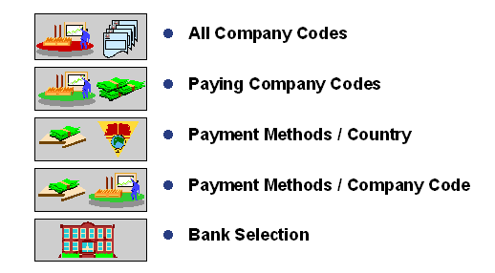
Structure of Payment Program
Transaction Code: FBZP
Most of the settings for the payment program can be accessed directly through the user side of the application. The settings are divided into the following categories:

Slide 49
Settings for Payment Run Program
1. All company codes
Inter-company payment relationships
The company code (s) that process payments
Cash discounts
Tolerances days for payments
The customer and vendor transactions to be processed
2. Paying company codes
For Each individual company code, define Minimum amount of incoming and outgoing payments
Forms for payment advice and EDI
Bill of exchange parameters
3. Payment methods / Country
Methods of Payment, Cheque, Bank Transfer etc.
Permitted Currencies
Print Programs
Document types for postings
4. Payment methods / Company code
Minimum and maximum payment amounts
Whether payments abroad and foreign currencies are allowed
Grouping options
Bank optimization
Bill of exchange specifications
Forms for payment media
Notes:
Prerequisities of payment processing in SAP.
The above mentioned settings have to in place before the payment program is run.

Slide 50
Settings for Payment Run Program
5. Bank selection
Ranking Order
Amounts
Accounts
Charges
Value Date
Postal Code
6. Bank selection: Ranking order
Per payment method , define the following …
Which house bank should be considered for payment first, second, third, etc.
Currency
Bill of exchange account
7. Bank Selection: Accounts and Amounts
Per house bank and payment method combination, define …
The offset account to the sub-ledger posting
Clearing accounts for bills of exchange
The available amount of funds in each bank
8. Bank selection: Charges
Assess additional bank charges for incoming and outgoing payments
Used with bill of exchange
Additional automatic posting configuration
Notes:
Prerequisities of payment processing in SAP.
The above mentioned settings have to in place before the payment program is run.

Slide 51

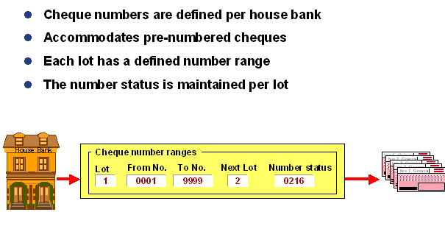
Cheque Lots
Notes:
Cheque lots are created before payment program is run

Slide 52
Main Steps to the Payment Process
1. Parameters:
2. Proposal:
3. Program:
4. Print:
Who is going to be paid?
What payment methods will be used?
When will they be paid?
Which company codes will be considered?
How are they going to be paid?
Once the parameters have been specified, the proposal run is scheduled and it produces a list of business partners and open invoices that are due for payment. Invoices can be blocked or unblocked for payment.
Once the payment list has been verified, the payment run is scheduled. A payment document is created and the general ledger and sub-ledger accounts are updated.
The accounting functions are completed and a separate print program is scheduled to generate the payment media.
Notes:
The payment process consists of setting up the parameters like vendors,paying Company codes,Payment method,Date on which payment will be made.
This is followed by creation of payment proposal .
The program will also contain a variant which gives details like bank,cheque lot etc.
The payment media generating happens as a last step in payment program.

Slide 53
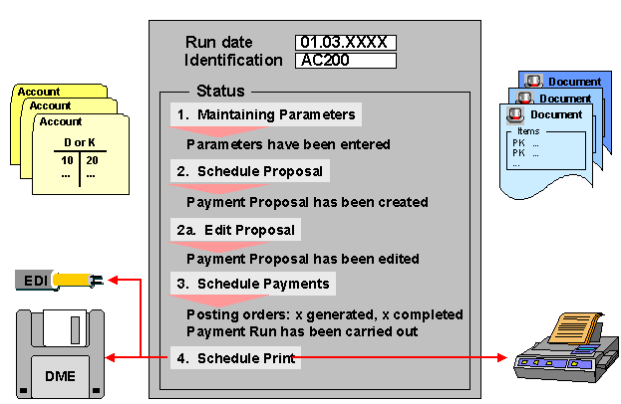
R/3 Payment Overview
Notes:
Slide shows how the payment program is done in SAP.

Slide 54
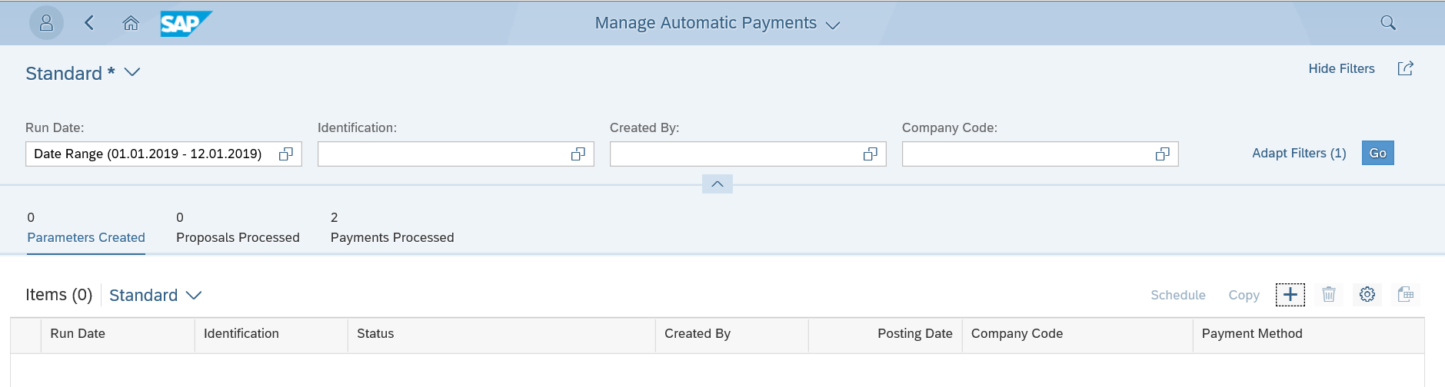
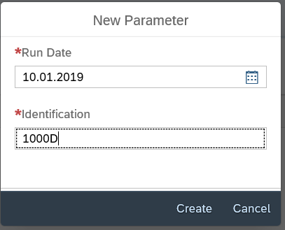
Fiori Tile: Manage Automatic Payments
1.Click on “+” to create the New payment Run
2.Give the Run Date and Identification

Slide 55
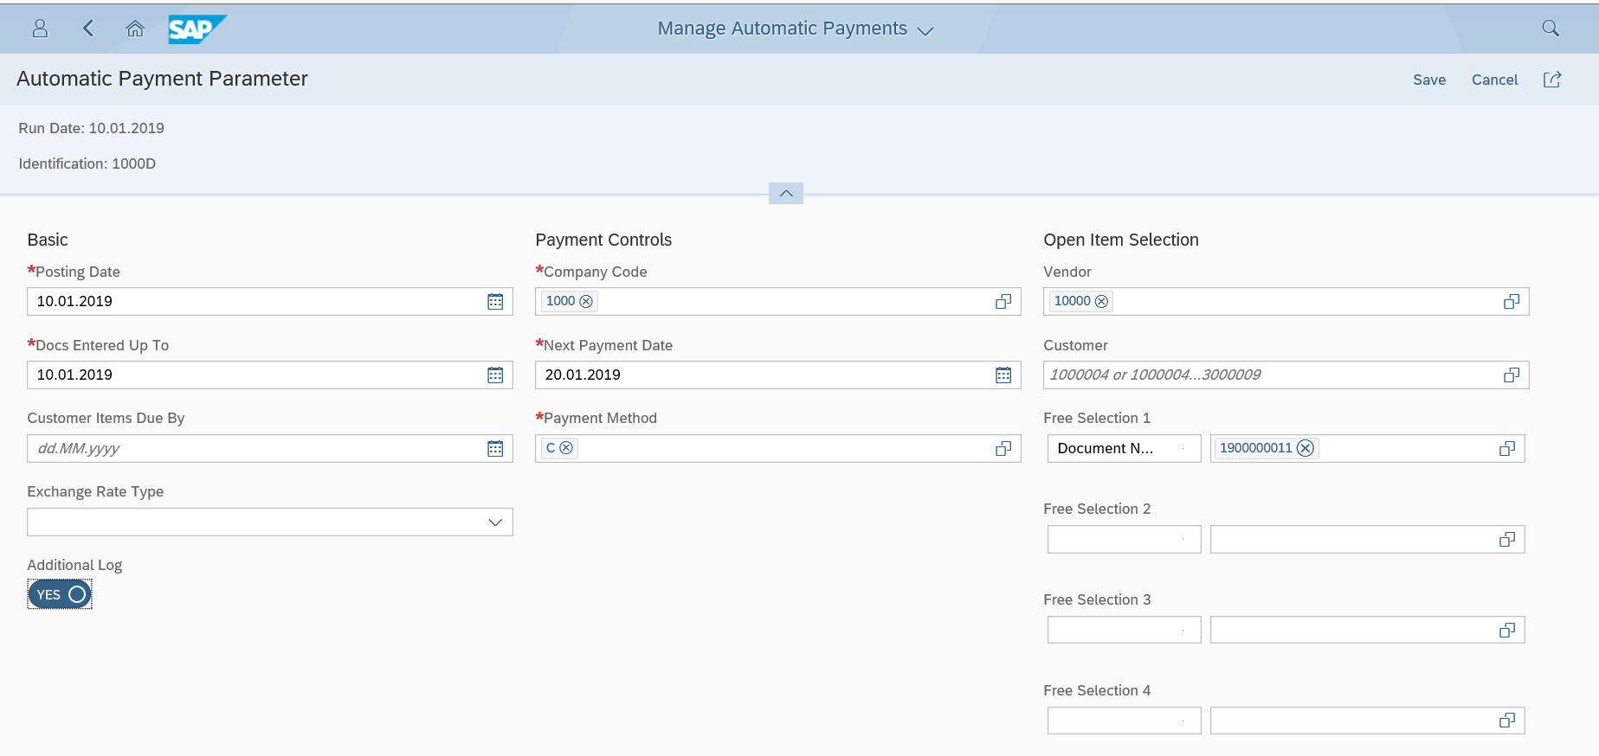
Fiori Tile: Manage Automatic Payments
4.Click on Save after entering the details
3.Enter the below details
Posting Date
Company Code
Vendor
Next Payment Date
Document number to be cleared/paid

Slide 56
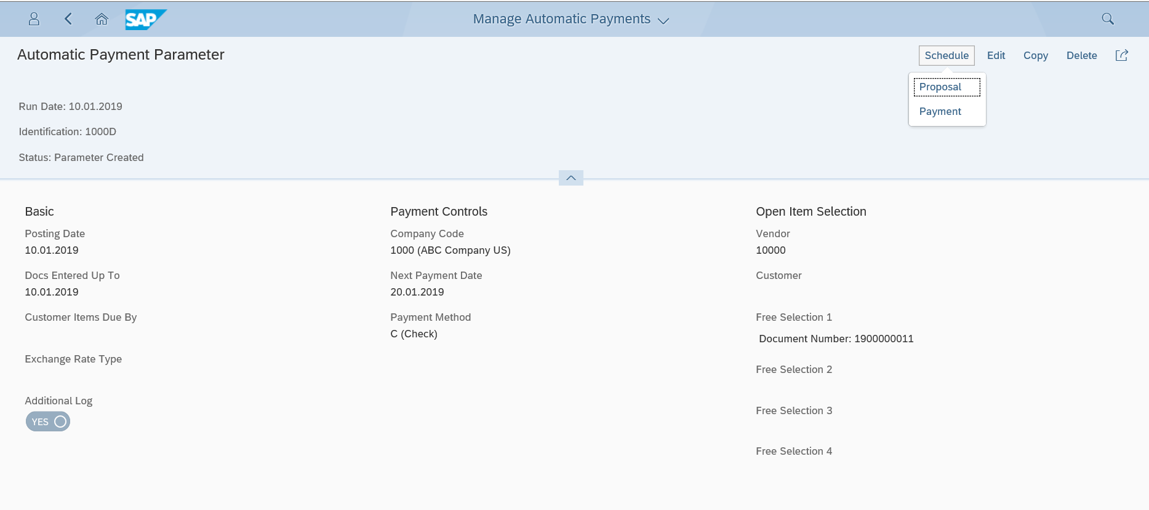
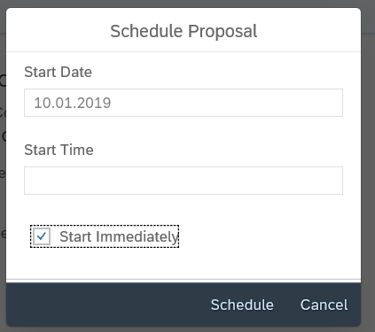
Fiori Tile: Manage Automatic Payments
5.Click On Schedule
6.Check “Start Immediately”.

Slide 57
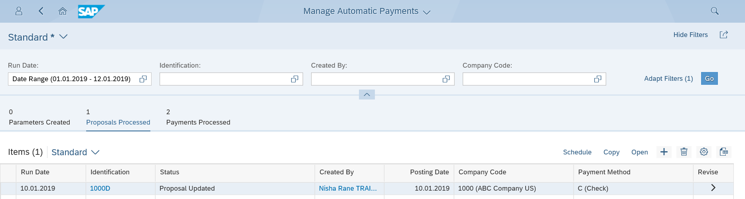
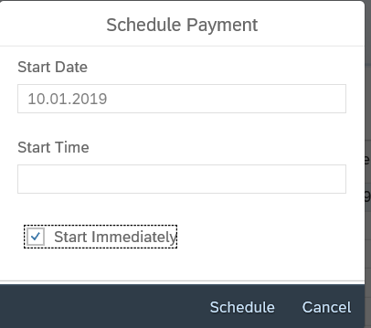
Fiori Tile: Manage Automatic Payments
Proposal Scheduled and Updated
7.Click on Schedule Payment
8.Click on Start Immediately and click Schedule

Slide 58
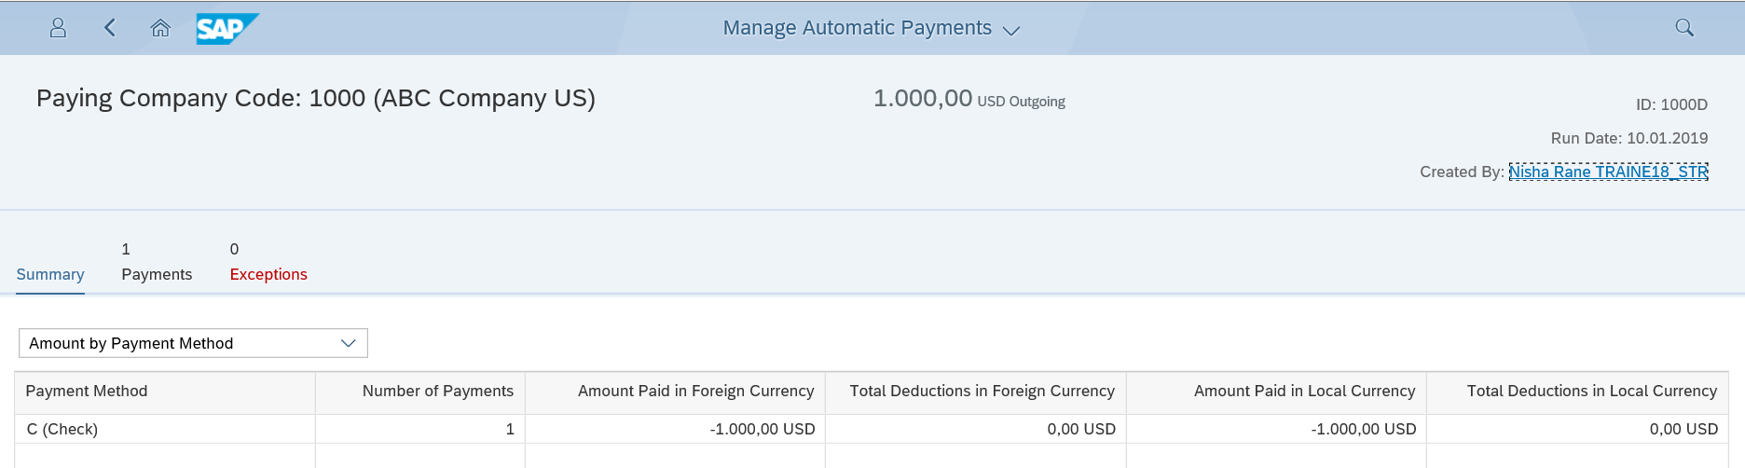
Fiori Tile: Manage Automatic Payments
9.Payment posted.

Slide 59
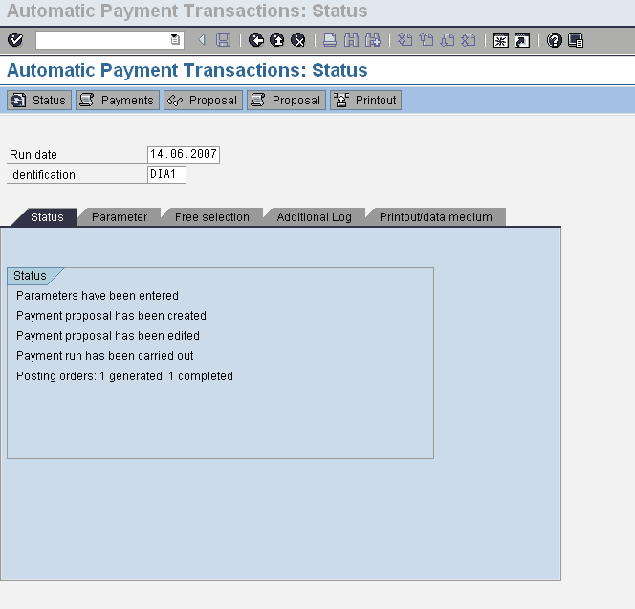
Payment Program Run

Slide 60
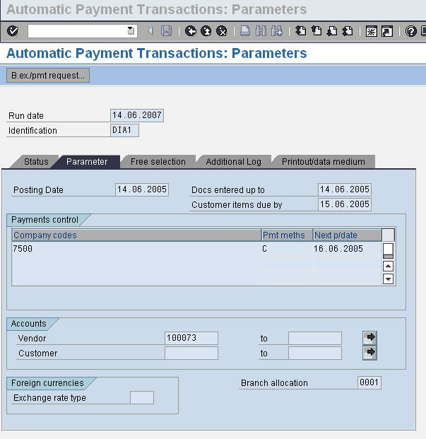
Parameter Screen
Notes:
This slide shows about the various parameters entered for payment run.
Posting data:
Document entered up to what date.
Vendor Account number ranges and payment methods and next payment date.

Slide 61
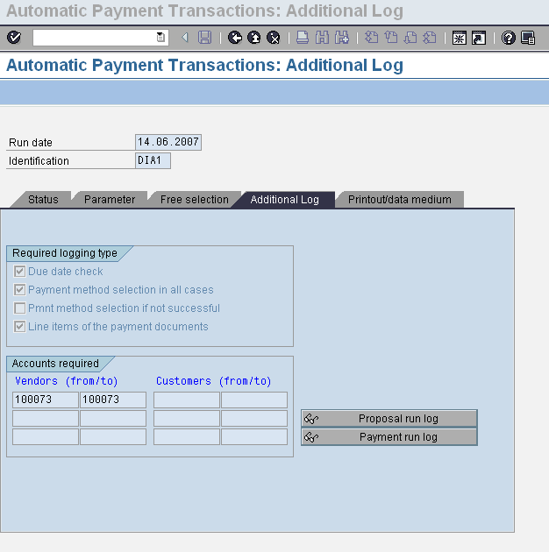
Additional Logging Type

Slide 62
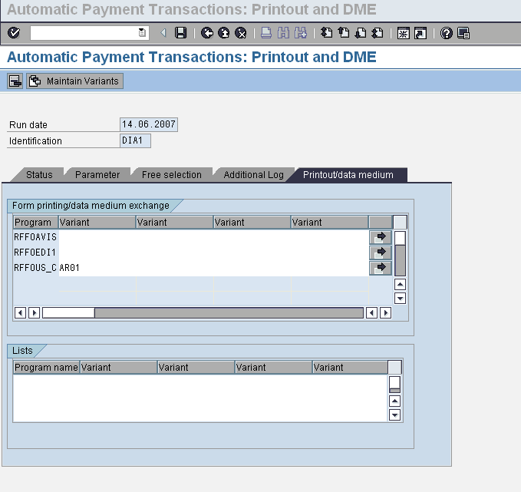
Print Out / Data Medium
Notes:
This slide shows more about printout and which data medium is used for carried out the payment program run.

Slide 63
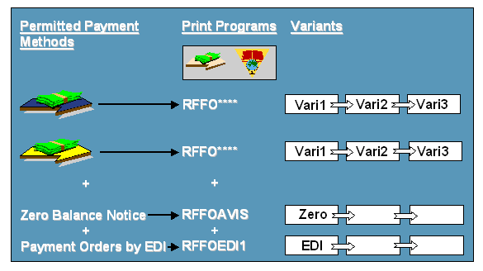
Print Program
Define in Print Programs
Variants for Print Programs
To each payment method per country, a print program is assigned in configuration
To run the print programs the system needs at least one variant per print program, if several variants are allocated to a print program, the program will run once per variant
The Program Run Date and Identification Feature fields can be left free in the variants. These fields are filled dynamically when the program is run
Notes:
Print program and the variants are configured for each company code and payment methods

Slide 64
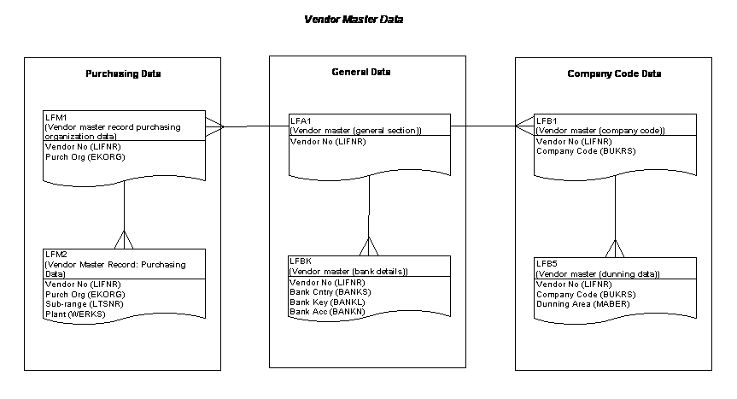
Database Tables for FI-AP
Table Name Description
LFB5 Vendor Master Dunning Data
LFBK Vendor Master Bank Details
LFC1 Vendor Master Transaction Figures
LFC3 Vendor Master Special GL Transactions
LFA1 Vendor Master (General Section)
LFB1 Vendor Master (Company Code section)
LFM1 Vendor Master record Purchasing org data
LFM2 Vendor Master record: Purchasing Data

Slide 65
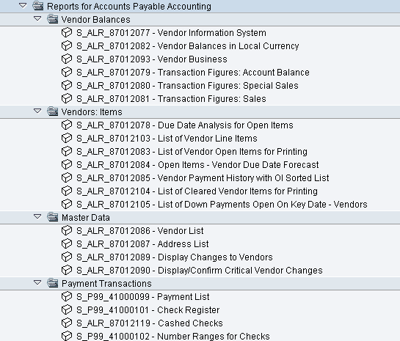
Standard Reports: Vendors

Slide 66
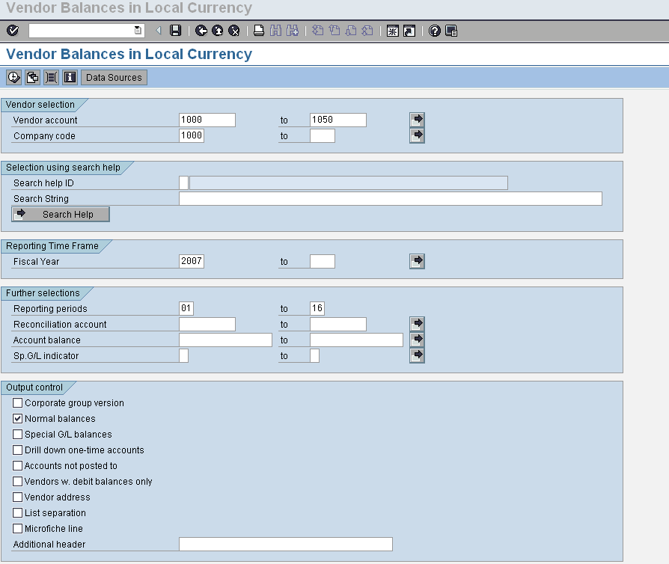
Selection Criteria
Notes:
Here we have to select certain criteria for report generation.
Vendor number
Company code
Fiscal year
Period

Slide 67
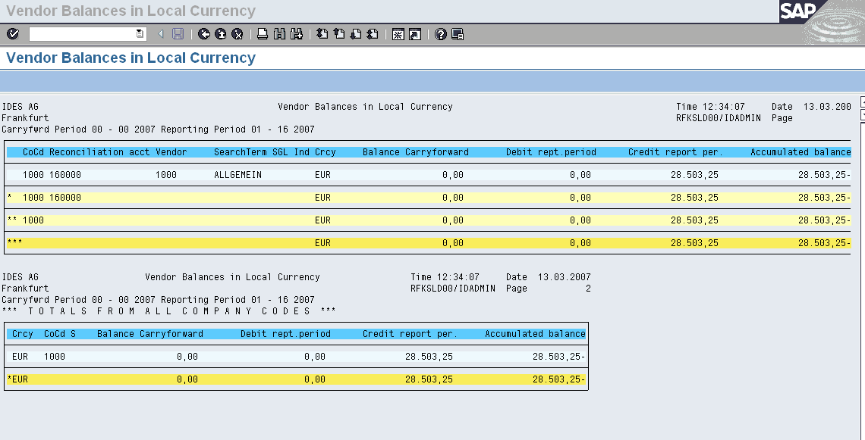
Reports
Notes:
Based on selection criteria reports being generated.

Slide 68
Standard Reports
Reporting Tools
R/3 gives two tools to use when executing reports: Variants and area or reporting menus
The same report menus in the application area can be accessed from the information system as well. The reports are broken down into different “logical” categories within each application area i.e. balance reports, line item reports and master data reports

Slide 69


Reports ?
Notes:
The same report menus in the application area can be accessed from the information system as well. The reports are broken down into different “logical” categories within each application area i.e. balance reports, line item reports and master data reports.
From the main SAP menu, System, Services, Reporting takes users to general reporting. Next, enter the eight character program name, enter selection criteria and then execute the report. If you do not know the technical program name, wild cards can be used to bring up a list of reports to choose from.

Slide 70

Reporting Tools

Slide 71
Report Name Structure
Most Financial reports begin with an RF prefix.
Vendor Reports Starts with: RFK _ _ _ _ _ _ _
RFKKVZ00
RFKOFW00
VENDOR LIST
VENDOR DATE FORCAST
Notes:
R/3 standard delivered reports have an eight character report name with some built-in logic. For example, in accounts payable, the vendor list is RFKKVZ00, but in accounts receivable, the customer list is RFDKVZ00.

